Slide 1
IDA PROJECT
The digital divide is when not everyone can use a computer or the Internet
Bridging the digital divide
for people with intellectual disabilities
Inclusive Digital Academy Agreement No. 2019-1-EN01-KA204-063005

Slide 2
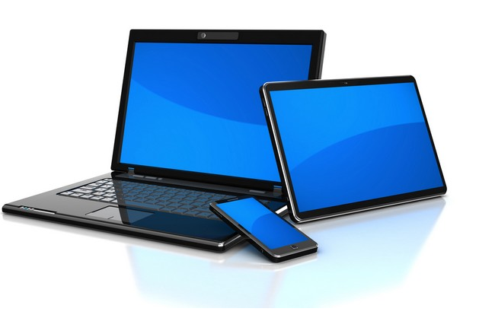
Today everyone should be able to use
a tablet
a computer
a smartphone

Slide 3
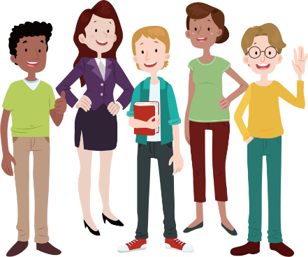
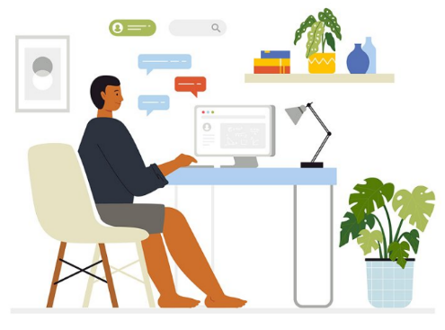
It is increasingly needed for
communicate
get organised
get informed
and many other things

Slide 4
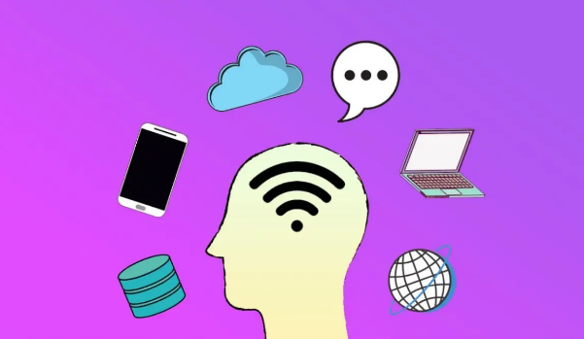
But often it is too complicated
the different tools are not suitable for all

Slide 5
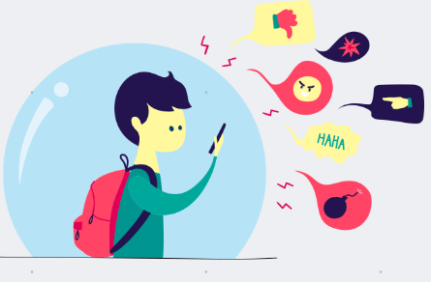
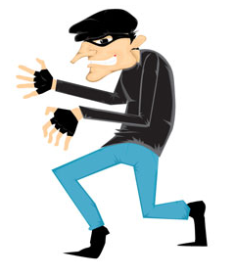
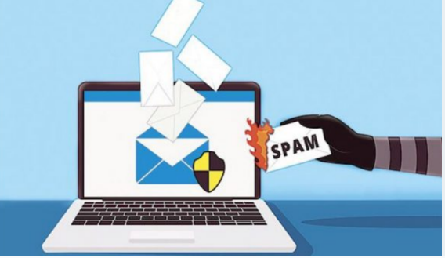
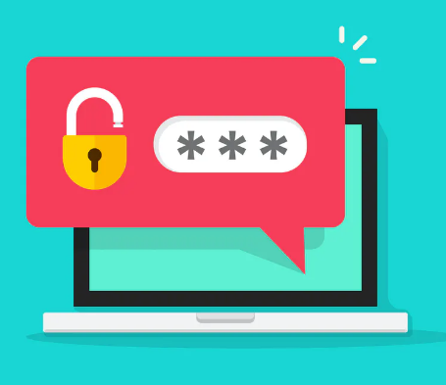
The digital world can also be dangerous
Care must be taken

Slide 6
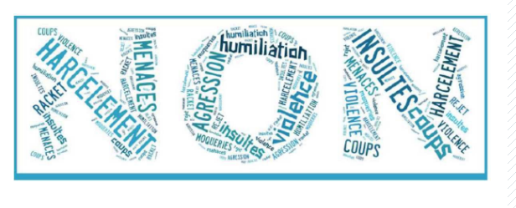
This is why the IDA project was created
Digital means computers, laptops, tablets but also what you can do with them
To facilitate access to digital technology
And warn of dangers

Slide 7
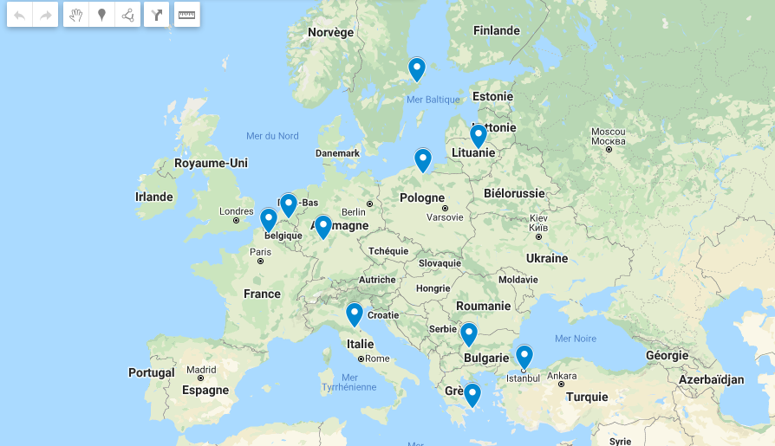
We are 10 countries participating in this project

Slide 8
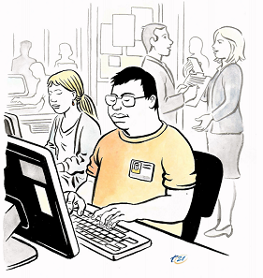
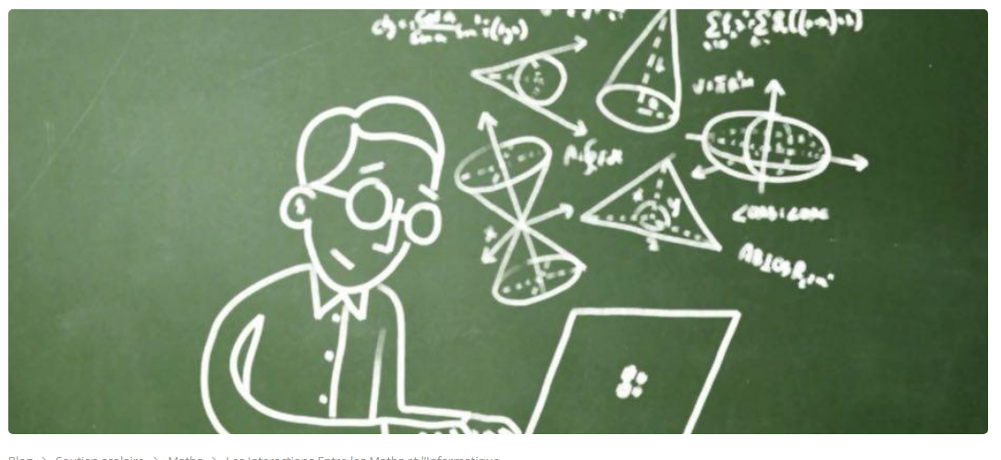
There are different groups of people working together
People with disabilities
Professionals
IT specialists

Slide 9
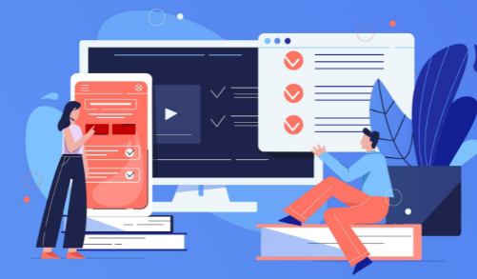
The role of the people with disabilities
and the professionals is to
Testing what exists
Identifying difficulties
Making proposals

Slide 10
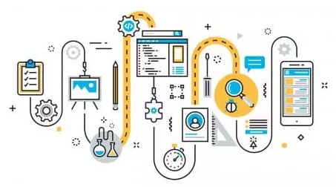
The role of IT specialists is to
A digital solution is a tool that responds to a need thanks to IT
Search for suitable digital solutions

Slide 11
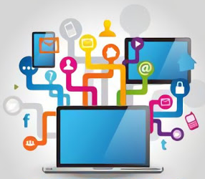
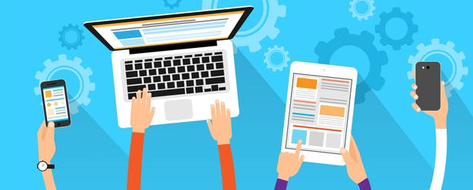
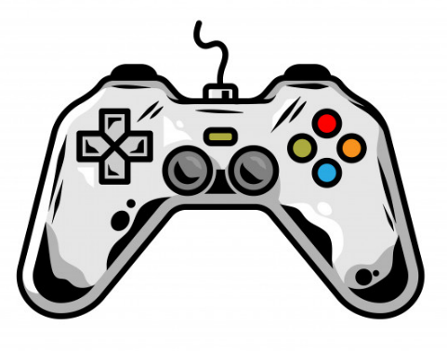
The tools we want to create
guides to learning
new applications
video games
animated films

Slide 12
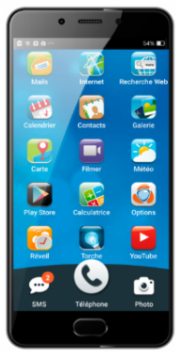
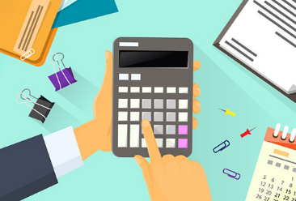
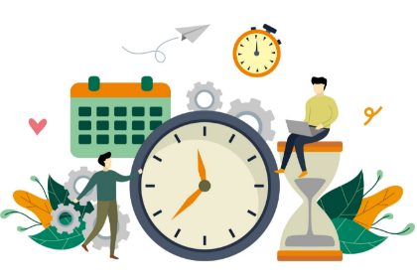
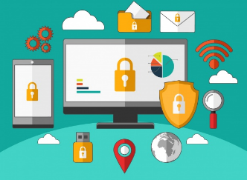
The first tools in progress
Guides for
know how to use
an e-mail service
social networks
video-conferencing
a smartphone
applications for
manage your budget
get organised
games
films on
safety

Slide 13
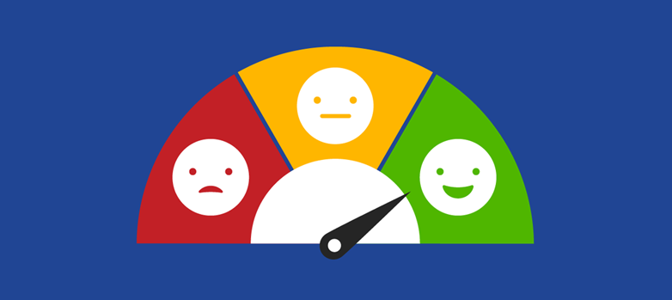
These tools will be easy to access
easy to read and understand
friendly
step by step

Slide 14
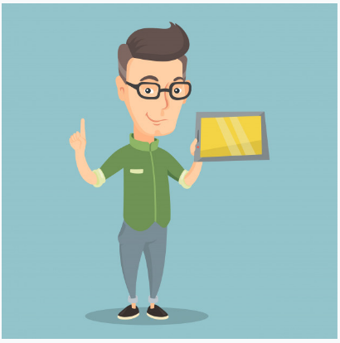
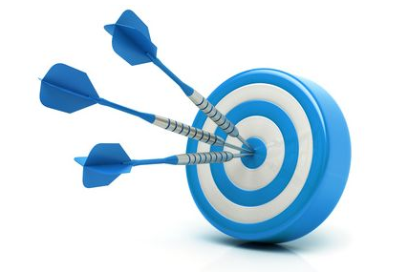
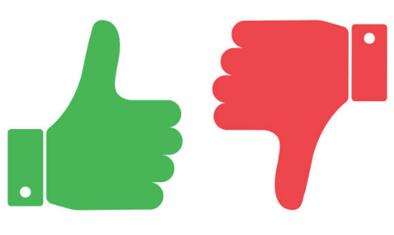
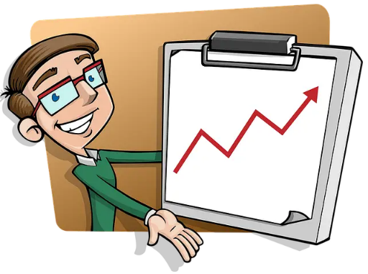
When the tools are ready we organise a training session
to learn how to use them
it allows you to test them
to improve them
and finalise them

Slide 15
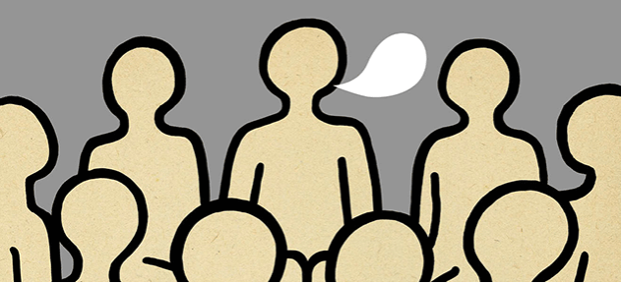
We hope that many people will use these tools
For access to the digital world for all

Slide 16
Thank you for your attention
Inclusive Digital Academy Agreement No. 2019-1-EN01-KA204-063005

